Slide 1





Demonstrating an Effective Marine Biodiversity Observation Network in the Santa Barbara Channel
Marine Science Institute
University of California Santa Barbara

Slide 2




Who we are
Principal/Associate Investigators
Marine Science Institute
Robert Miller, Andrew Rassweiler, Daniel Reed, Milton Love
Ecology Evolution and Marine Biology
Craig Carlson, Deborah Iglesias-Rodriguez, Doug McCauley
Geography
David Siegel, Phaedon Kyriakidis
Electrical and Computer Engineering
BS Manjunath
USGS
Kevin Lafferty
UCSD - SIO
John Hildebrand
NOAA – NMFS SWFSC
Andrew Thompson

Slide 3




Who we are
Partners
Southern California Coastal Water Research Project
Channel Islands National Marine Sanctuary
Santa Barbara Coastal Long-Term Ecological Research Program
Channel Islands National Park
Southern California Coastal Water Research Project
Southern California Coastal Ocean Observing System (SCCOOS)
Plumes and Blooms
Gray Whales Count
San Onofre Nuclear Generating Station Mitigation Monitoring CalCOFI

Slide 4
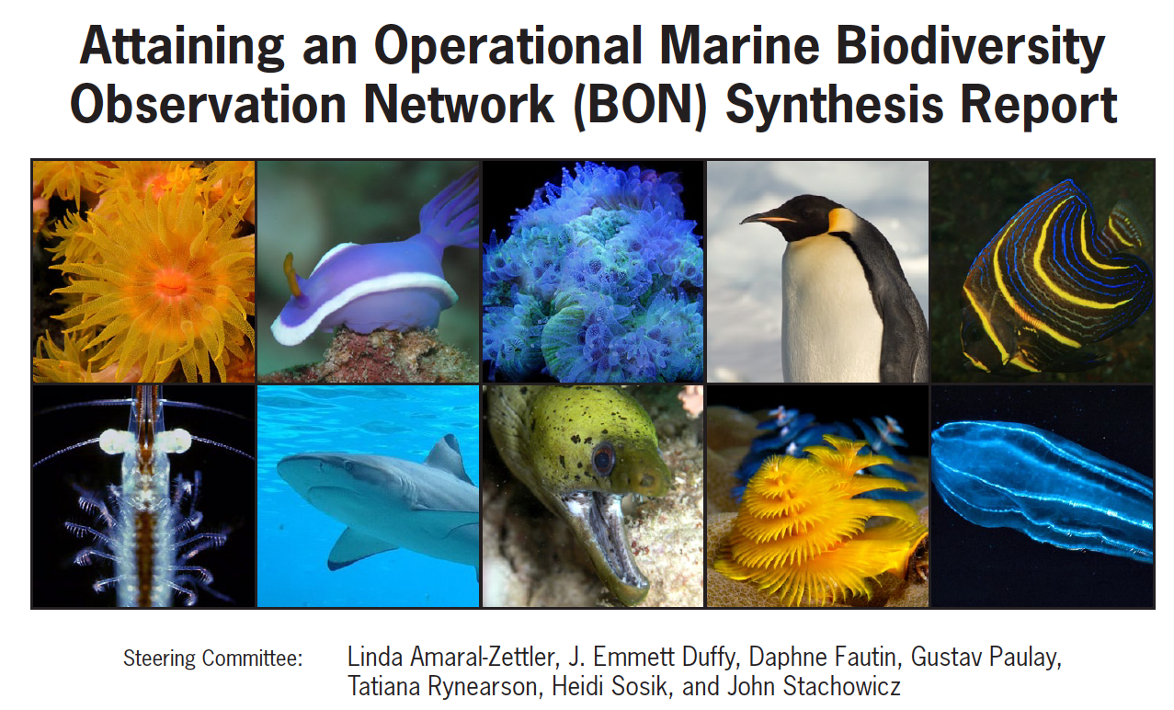
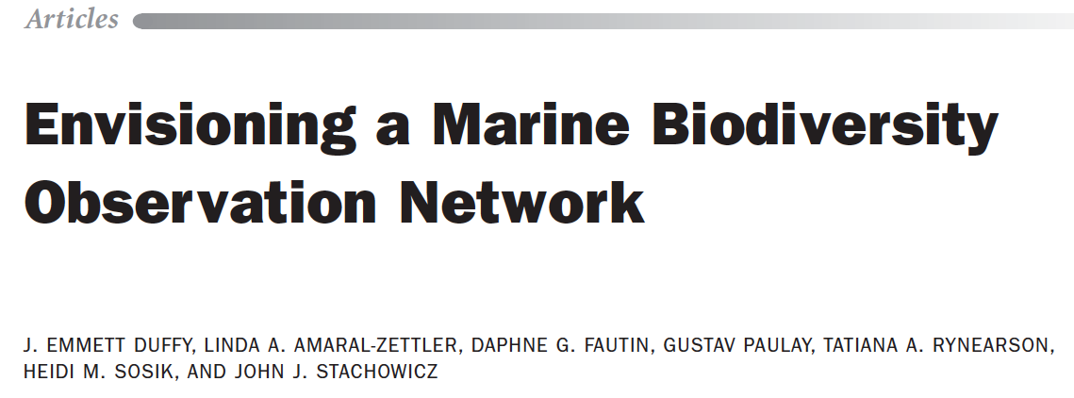

Notes:
Therefore, in May 2010, the Biodiversity Ad Hoc Group under the Interagency Working Group on Ocean Partnerships convened a workshop of experts to develop a plan and recommendations for attaining an operational marine biodiversity observation network (Marine BON) for the nation.

Slide 5
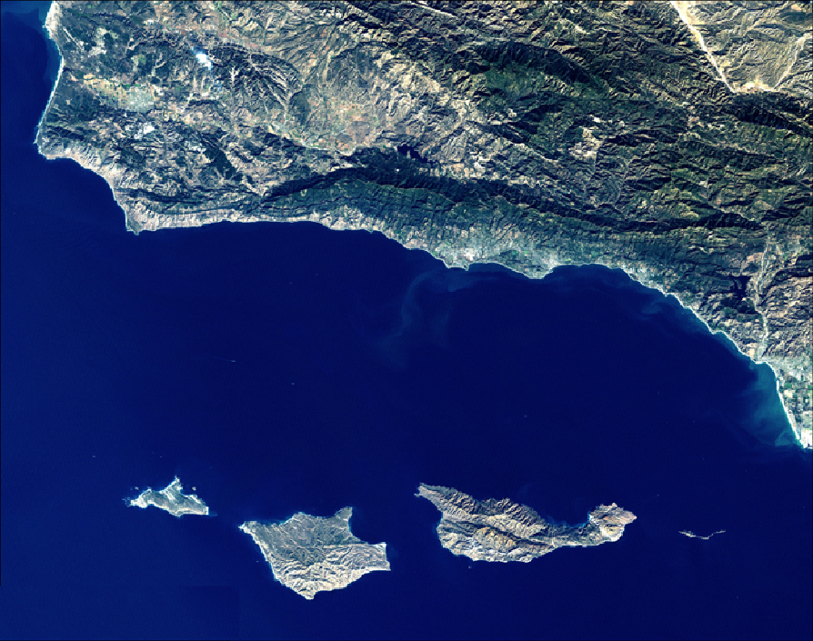
Dec 2, 2013
The agencies are requesting proposals… that demonstrate how an end-to-end marine BON can be developed. “End-to-end” refers to integration of observations and data across multiple scales of diversity (genetic to ecosystem, microbes to whales), time (instants to centuries), and space (in situ to satellite remote sensing).
Notes:
Last year an RFP was issued by the NOPP to establish a prototype BON. The scope of needs for a BON was quite wide. In reading the rfp we realized that here on our doorstep was likely the best region for such a prototype network: the Santa Barbara Channel.

Slide 6
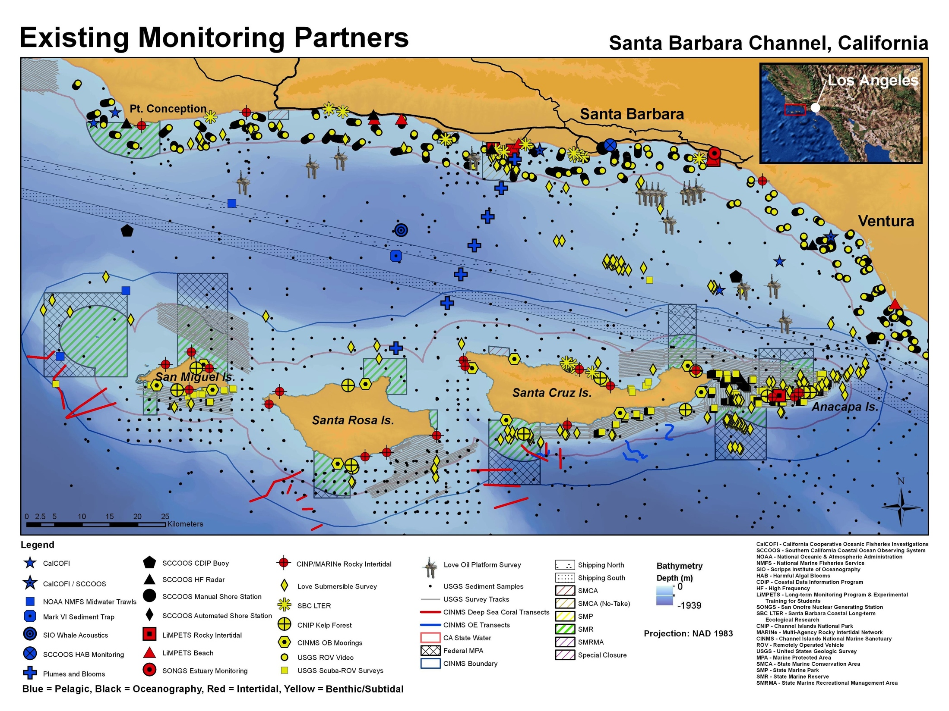
Intertidal
  CINP, MARINe (BOEM), SBC LTER (NSF), PISCO
Shallow benthos
  CINP, SBC LTER, SCCWRRP, PISCO
Deep Benthos
  CINP, Love Lab (BOEM), USGS
Pelagic
  Plumes & Blooms (NASA, NOAA), CalCOFI, NOAA NMFS, Gray Whales Count
Notes:
First SBC has likely one of the highest densities of in situ observations, both physical and biological, in the world. This map shows locations of ongoing monitoring of everything from rocky intertidal communities to kelp forests and deep reefs and oil platforms.
Partnership of interdisciplinary studies of coastal oceans

Slide 7
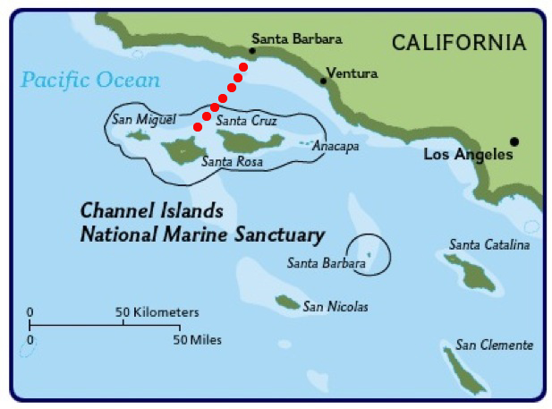
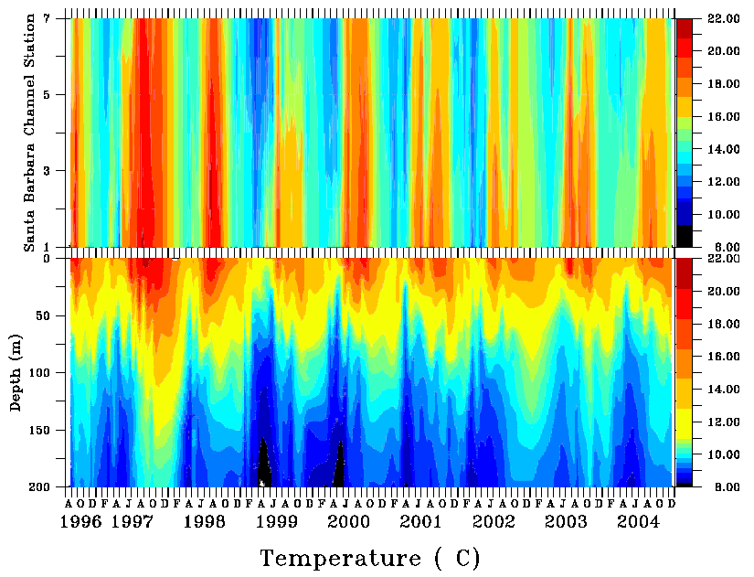
Plumes & Blooms
Measurements
  CTD/optics (L_{wN}(λ), a(λ), b(λ), b_{bb}(λ), PSD, etc.)
  NUTs, Chl, HPLC pigments, DOC, DIC, pSi
  Glider observations
Notes:
Plumes and Blooms, for example, has taken extensive in situ measurements at 7 stations across the channel every 6 weeks since 1996. These are examples of temperature profiles across nearly a decade that illustrate interannual variability in upwelling intensity.

Slide 8
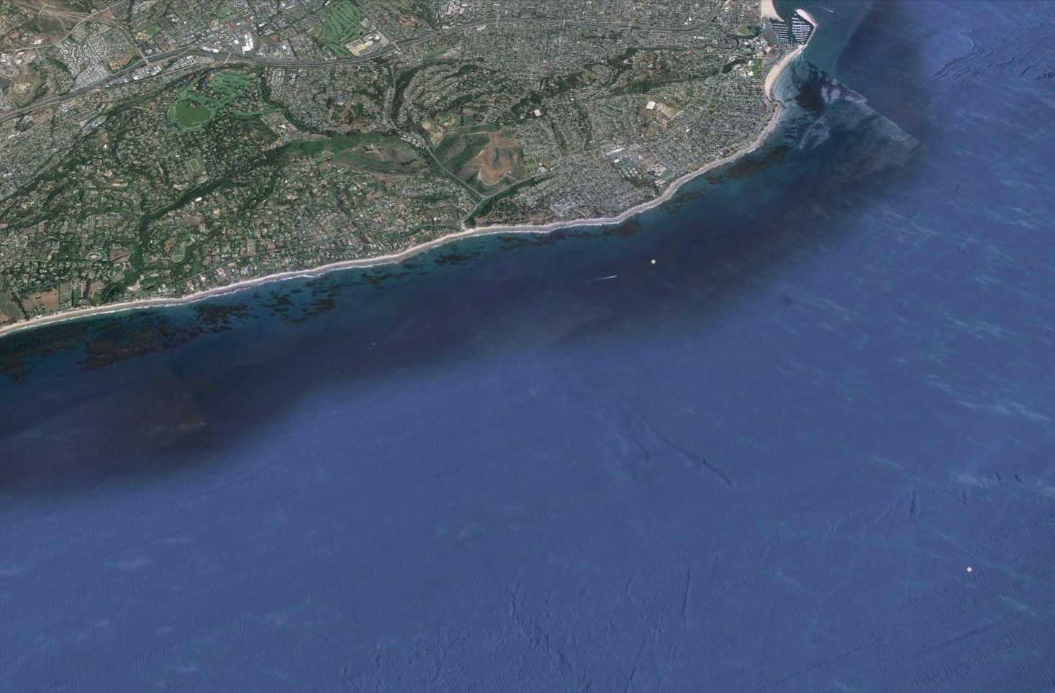

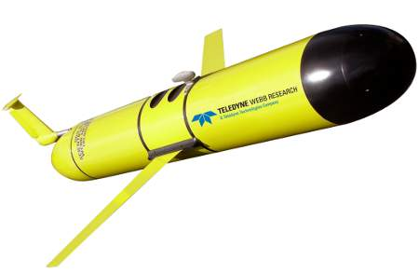
Over 400 cross-shelf snapshots
of optical properties
Kelp Forest
20m
4 km
Optical Instruments on glider | Equivalent biogeochemical property
Spectral backscatter | Particle load, POC
Chlorophyll fluorometer | Phytoplankton presence / “abundance”
CDOM fluorometer | Riverine inputs, upwelling
Dissolved Oxygen Optode | AOU, water mass tracking, NCP
Santa Barbara Channel
70m

Slide 9
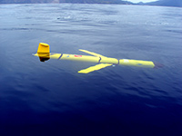
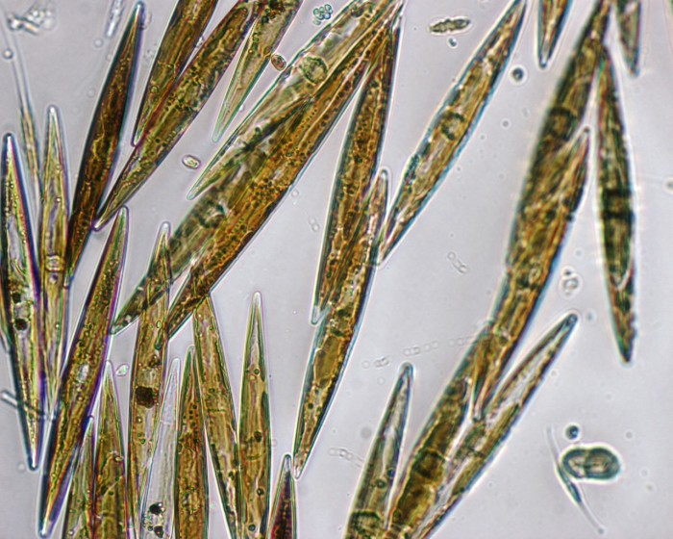
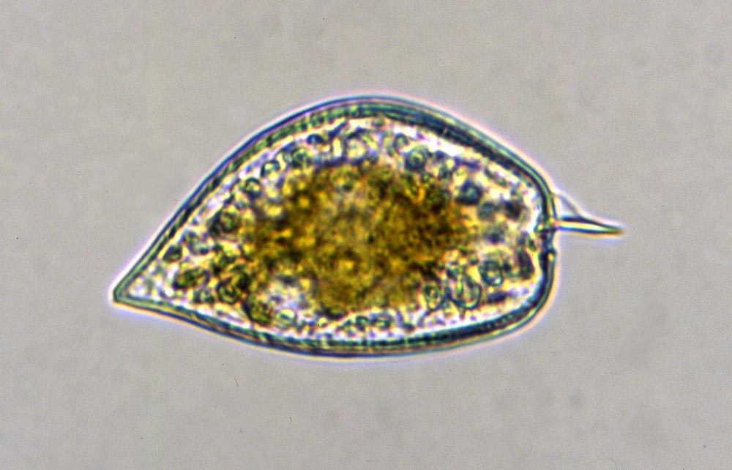
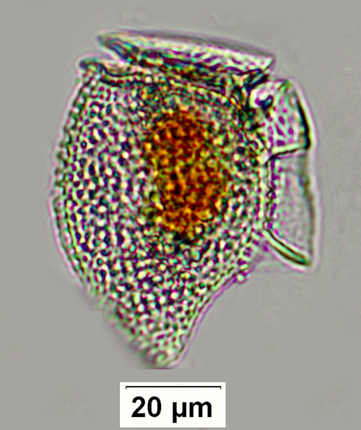
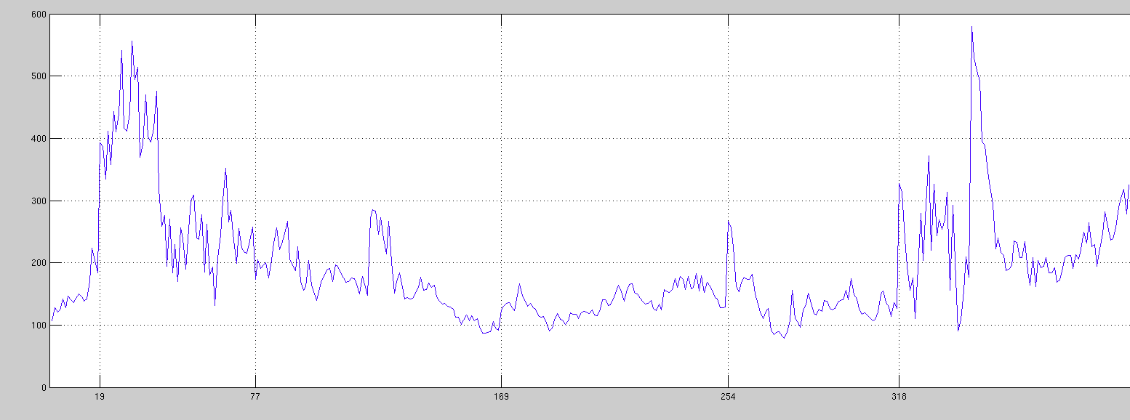
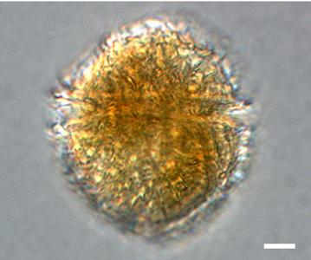
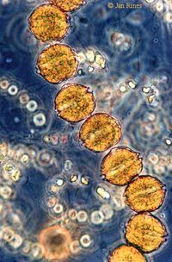


Fernanda Henderikx Freitas
David Siegel, Libe Washburn
Stuart Halewood, Erik Stassinos
Pseudo-nitzschia
Pseudo-nitzschia
Prorocentrum
Dinophysis
PC1 - Chl
Lingulodinium
Dinophysis
Alexandrium
Mar
Jul-Aug
Sept
Nov-Dec
Feb
June
2012
2013
Notes:
Now we can see how phyto patches propagate in time and space….PC1-chl = mean chl-fl (roughly every 3h, per mission. Missions were all added together to form one time series, and the period between missions was omitted).
Slope/PC4 = 4th eof mode of chl-fl variability, shows times where phyto is located more in the offshore portion of the section (negative values) or inshore of the section (positive values).
Here we can see that the big bloom during Jul/Aug 2012 started offshore, propagated inshore, and is was likely composed of pseudo-nitzchia. After that, phyto is mostly observed offshore , and the community might have changed as well.

Slide 10
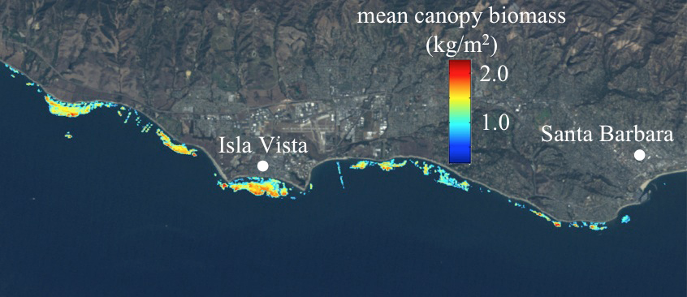
Landsat 5 Kelp Forest Biomass
Notes:
Since giant kelp abundance is so dynamic, capturing these changes requires a time-series with high temporal resolution. A giant kelp canopy biomass developed by Cavanaugh and others using Landsat 5 Thematic Mapper (TM) satellite imagery. The use of open access Landsat 5 TM images allowed canopy biomass estimates to be made across all of California every 1-2 months from 1984 – 2011. The spatial and temporal resolution and extent of the Landsat data has enabled researchers to examine the drivers of seasonal, annual, and decadal fluctuations in kelp abundance and productivity across a range of spatial scales, investing spatial synchrony of kelp biomass, characterize the patch dynamics of kelp forest ecosystems (Cavanaugh et al. 2014), and establish nonlinear relationships with environmental drivers.
Kelp patches 96% > 3600m2

Slide 11
Santa Barbara Channel (SBC) BON
Goals:
Integrate biodiversity data to enable inferences about regional biodiversity
Develop advanced methods in optical and acoustic imaging and genomics for monitoring biodiversity in partnership with ongoing monitoring and research programs
Implement a tradeoff framework that optimizes allocation of sampling effort

Slide 12
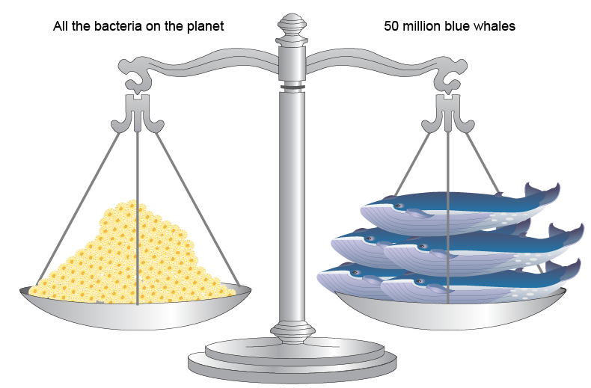
Integrate biodiversity data to enable inferences about regional biodiversity
Challenges:
Data collected at very different spatial and temporal scales
Very different types of organisms: microbes to whales
http://teachoceanscience.net/

Slide 13
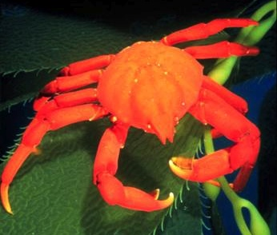
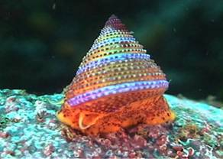
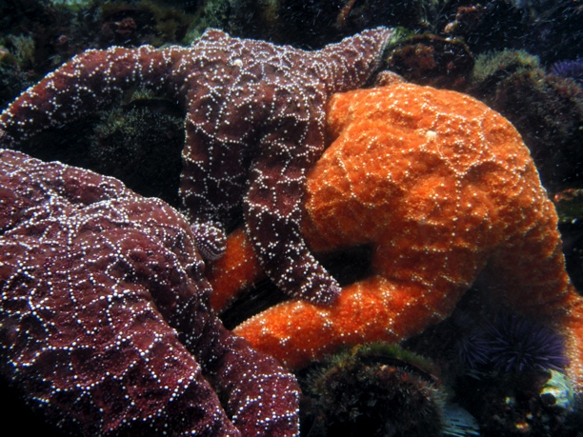
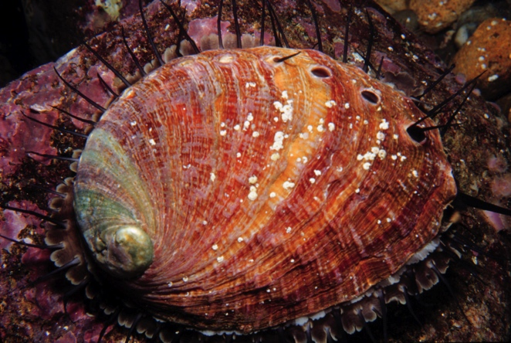
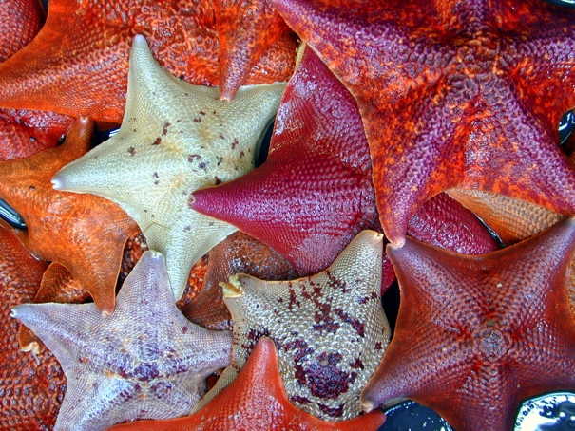
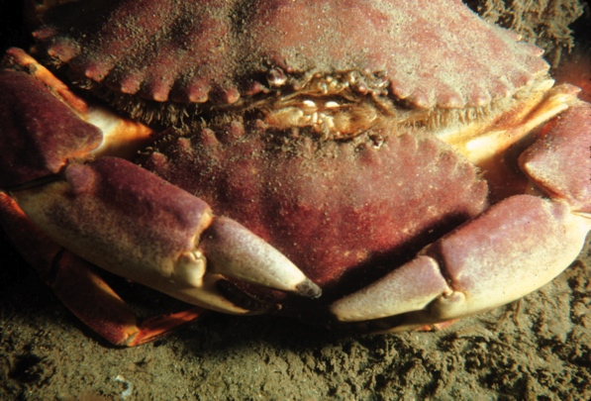
Integrate biodiversity data to enable inferences about regional biodiversity
Approach:
A) Focus on taxocenes and communities - comparable sets of organisms e.g. microbes, benthic megafauna

Slide 14
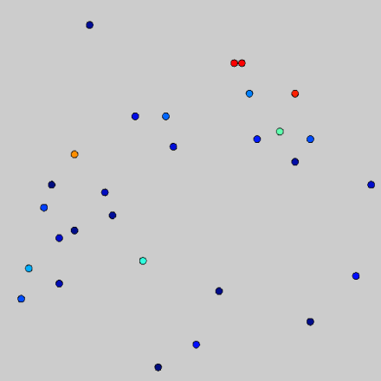
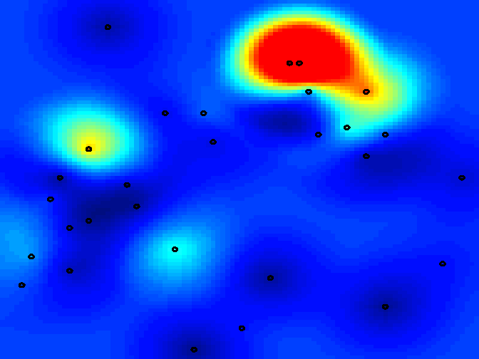
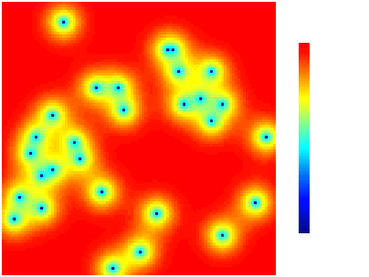
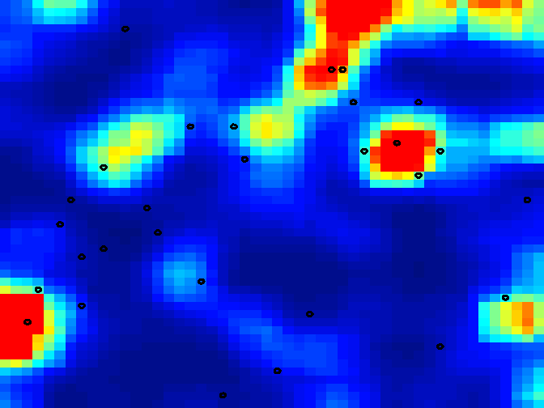
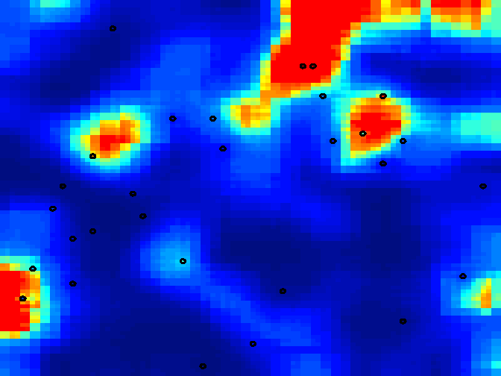
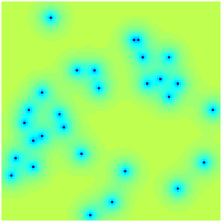
Integrate biodiversity data to enable inferences about regional biodiversity
Approach:
B) Use geospatial statistics and predictive modeling to extrapolate these measurements to larger scales
direct measurements
optimal estimates
uncertainty
10
0
integration
&
expansion
100x100
sparse
Using direct data only
indirect measurements
uncertainty
Scaling
accounting for
data resolution
data accuracy
100x100
100x100
abundant
Using direct + indirect data
Notes:
This will include the use of habitat variables such as kelp forests. This image illustrates the spatial distribution of kelp biomass estimated using landsat imagery groundtruthed with in situ measurements by SBC LTER.

Slide 15
Landsat 5 Kelp Forest Biomass
Notes:
Since giant kelp abundance is so dynamic, capturing these changes requires a time-series with high temporal resolution. A giant kelp canopy biomass developed by Cavanaugh and others using Landsat 5 Thematic Mapper (TM) satellite imagery. The use of open access Landsat 5 TM images allowed canopy biomass estimates to be made across all of California every 1-2 months from 1984 – 2011. The spatial and temporal resolution and extent of the Landsat data has enabled researchers to examine the drivers of seasonal, annual, and decadal fluctuations in kelp abundance and productivity across a range of spatial scales, investing spatial synchrony of kelp biomass, characterize the patch dynamics of kelp forest ecosystems (Cavanaugh et al. 2014), and establish nonlinear relationships with environmental drivers.
Kelp patches 96% > 3600m2

Slide 16
HyspIRI (AVIRIS) Kelp Forest Pigments
UCSB
Chl:C (mg mg⁻¹)
Depth (NOAA National Geophysical Data Center coastal relief model)
Depth (m)
r = 0.41
p < 0.001

Slide 17
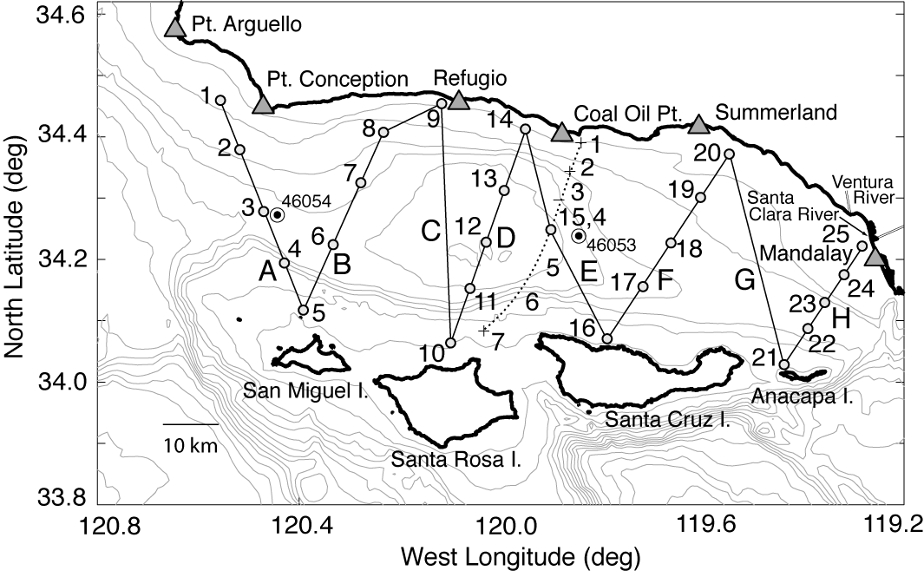
Integrate biodiversity data to enable inferences about regional biodiversity
Approach:
C) Collect additional data obtained from intensive sampling campaigns that are spatially distributed within habitats
Notes:
To inform these modeling efforts and tell us how well existing observations are doing at descibing biodiversity, we will plan to collect additional data in intensive sampling campaigns. For example we plan to execute a more extensive cruise in the mode of plumes and blooms to examine spatial patterns of planktonic biodiversity in the channel.

Slide 18
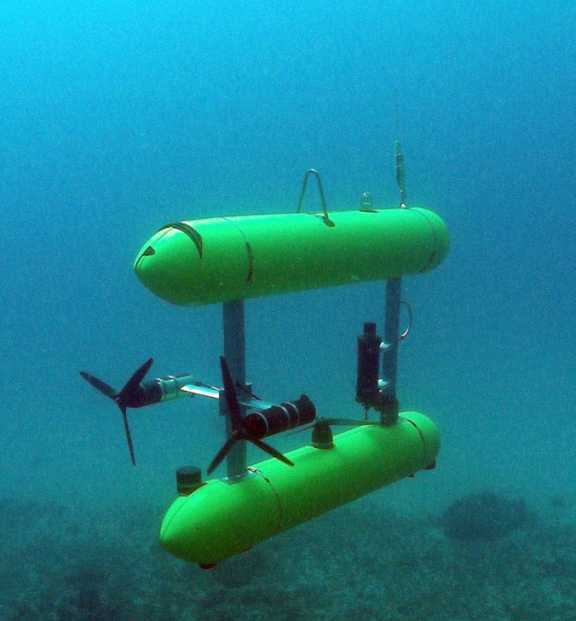
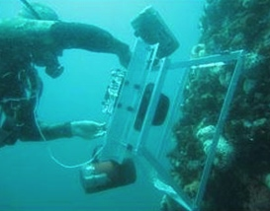
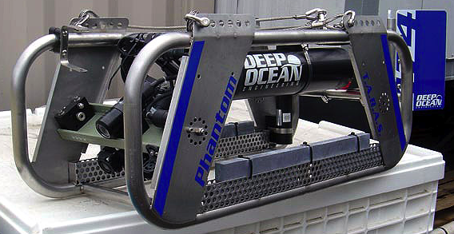
Goal 2. Develop advanced methods in optical and acoustic imaging and genomics for monitoring biodiversity
Optical Imaging
Notes:
Imaging often used in underwater science to maximize the info gathered during limited and high-cost dives
But this produces hours of video and many images that then need to be analyzed

Slide 19
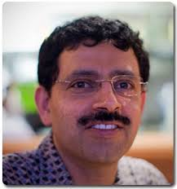


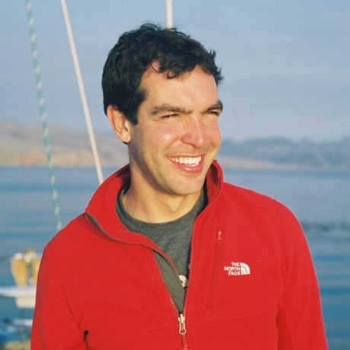
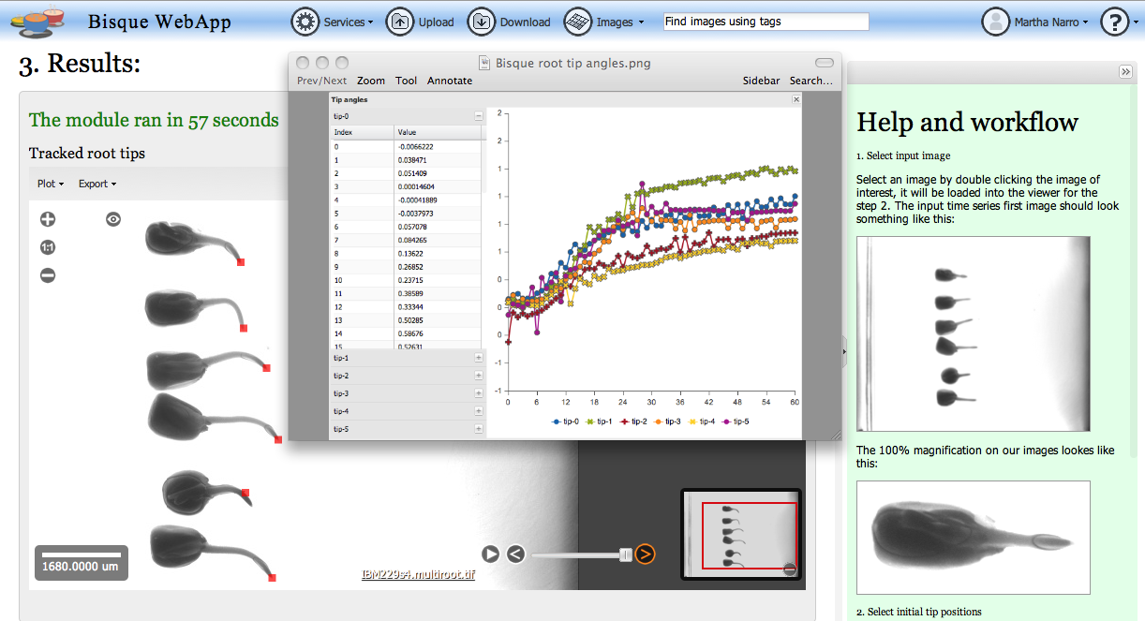
Notes:
Manjunath leads the center for bio-image informatics here in the electrical and computer engineering department. His group has developed a data management and analysis environment called bique, which has been applied to diverse datasets in biomedical research, developmental biology and ecology.

Slide 20
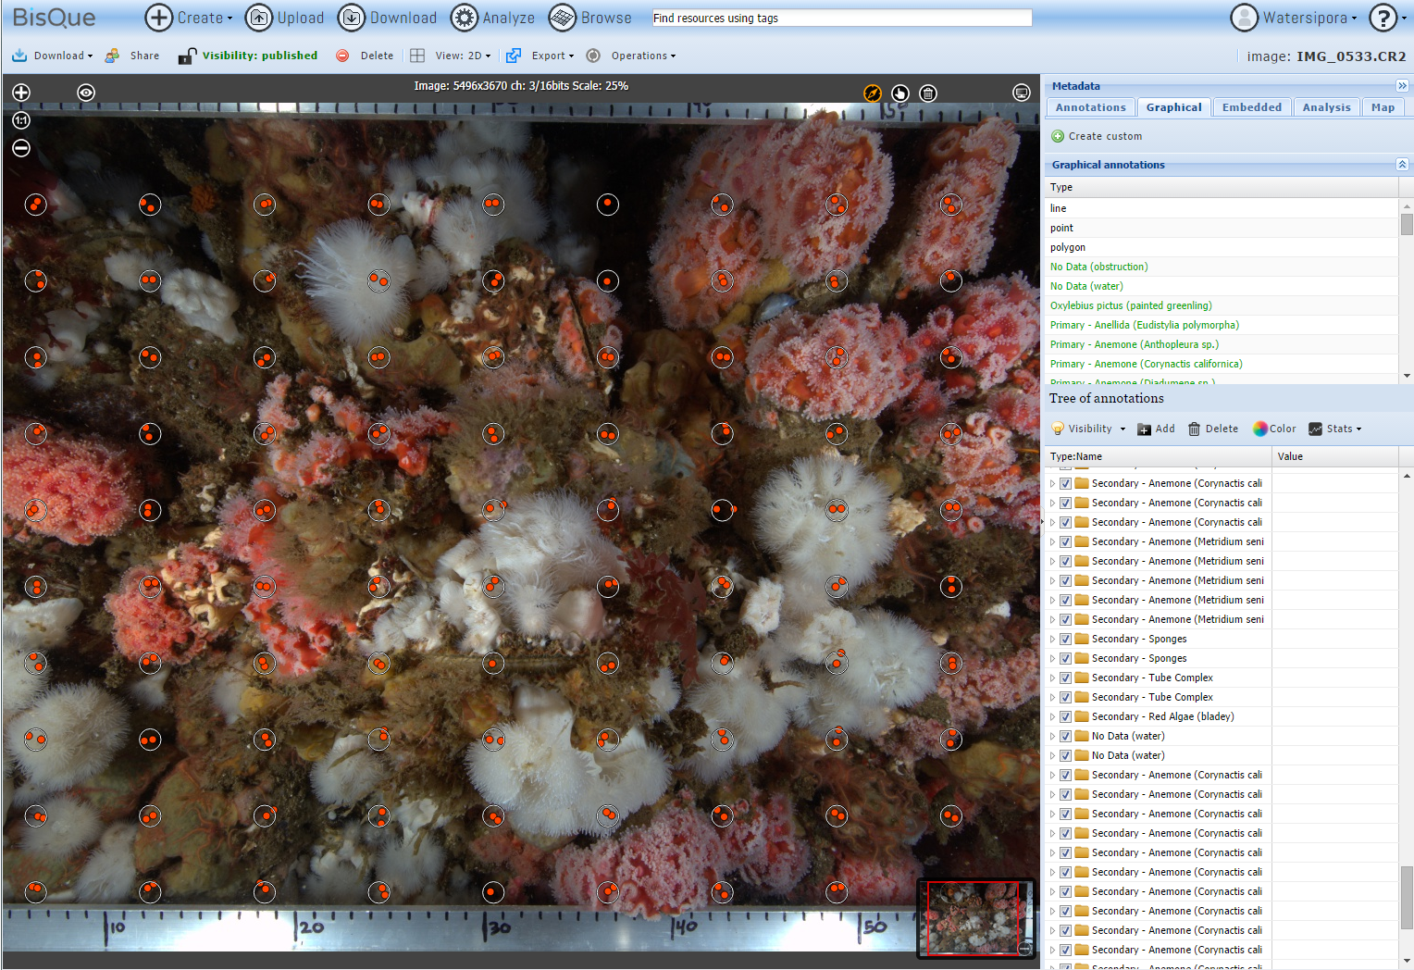
Notes:
In a BOEM-funded project on sessile invertebrate communities living on offshore oil platforms, we have used bisque to quantify cover of invertebrate species. The system has been very useful in manual identification as shown here, where an observer has identified organisms under the grid of dots to estimate cover. A graduate student in Manjunath’s group, Amir Rahimi, developed an algorithm to identify the most common species, and was able to achieve >70% accuracy for the 7 most common species.

Slide 21
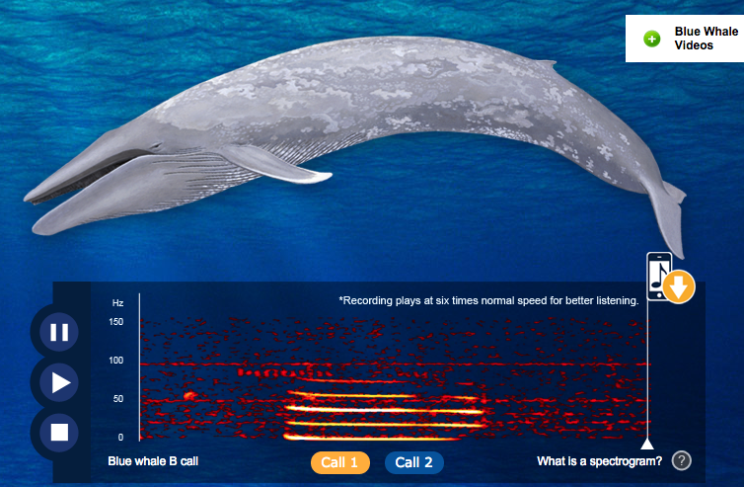
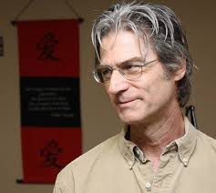
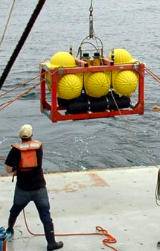
Goal 2. Develop advanced methods in optical and acoustic imaging and genomics for monitoring biodiversity
Acoustics
Notes:
Acoustics is another form om of imaging that SBC BON will use to assess biodiversity. This effort will be focused on marine mammals, for which acoustics is a proven technology for population assessment. We will be expanding the use of acoustics in the channel to identify as many species of marine mammals as possible focusing particularly on whales and dolphins. This part of the project is being led by John Hildebrand of Scripps. This is a screenshot form John’s outreach website, called voices of the sea.

Slide 22
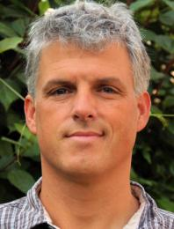
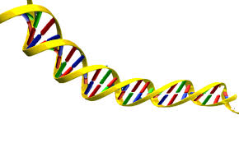
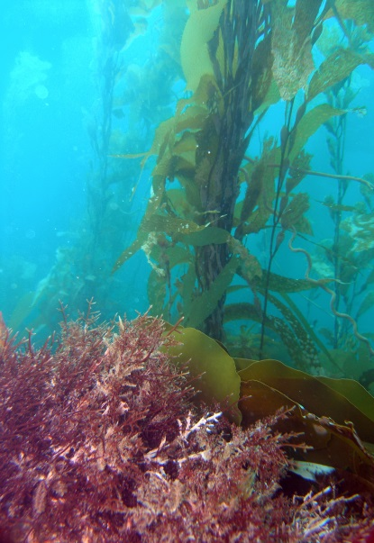
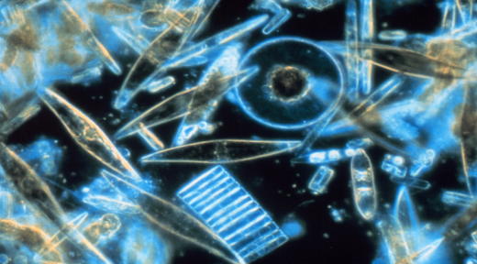
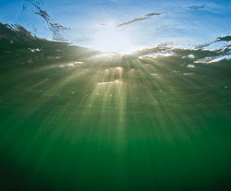
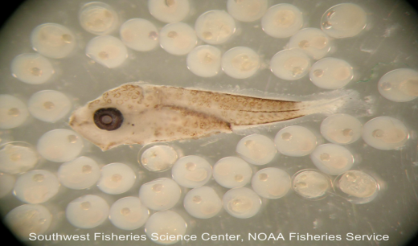
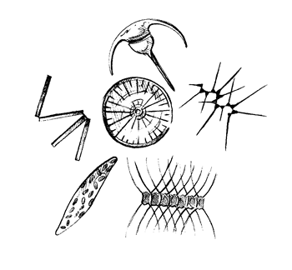
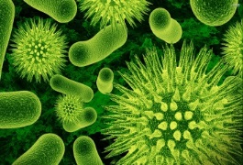
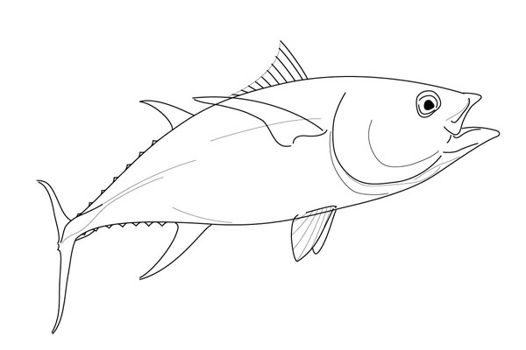
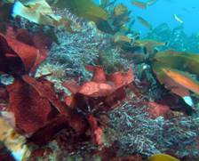
Goal 2. Develop advanced methods in optical and acoustic imaging and genomics for monitoring biodiversity
Targets:
Microbes
Microplankton
Ichthyoplankton
eDNA
Targets:
Microbes
Microplankton
Ichthyoplankton
eDNA
Molecular genetics
Total DNA collected on filters
Ecosystem
Targets:
Microbes
Microplankton
Ichthyoplankton
eDNA
Targets:
Microbes
Microplankton
Ichthyoplankton
eDNA
Targets:
Microbes
Microplankton
Ichthyoplankton
eDNA
Targets:
Microbes
Microplankton
Ichthyoplankton
eDNA
Amplification of barcode genes for particular groups (prokaryotes to vertebrates)
A Genomic View of Biodiversity Across Multiple Trophic Levels
Notes:
Led by Craig Carlson, SBC BON will be using genomics in three ways. First, prokaryotic and eukaryotic plankton diversity will be assessed using high-throughput pyrosequencing of DNA extracted from depth-integrated water samples collected using McLane pumps that enable filtration of large volumes of water in situ. This approach has been proven and has shown that the vast majority ofmarine microbial diversity was made up of unculturable species that were previously unknown. This will be done by two labs – Craig’s and that of Deborah Igesias-Rodriguez.

Slide 23





Goal 2. Develop advanced methods in optical and acoustic imaging and genomics for monitoring biodiversity
Genomics - Ichthyoplankton
Notes:
Second, genetic barcoding will be used to identify larval fish. Larval fish are hard to identify and it is painstaking work to sort them from plankton net samples. Andrew Thompson from the NOAA NMFS SWFSC will test our ability to montor abundance of larval fish by counting larvae from net tows and doing the genetics on the same samples.

Slide 24


Goal 2. Develop advanced methods in optical and acoustic imaging and genomics for monitoring biodiversity
Genomics - eDNA
Notes:
Finally, SBC BON will explore the utility of environmental DNA, or eDNA, on monitoring marine biodiversity. Organisms continually shed DNA into the water through a variety of processes from mucous shedding to whales spouting. This eDNA can survive for up to 7 days in the water and therefore provides an integrated look at what was in the water over that time. It is potentially very useful for monitoring rare or hard to observe specie. We plan to explore its use for monitoring deep-water rockfish species.

Slide 25
Goal 3. Implement a tradeoff framework that optimizes allocation of sampling effort
Sampling method 1
e.g. Diver counts
Information about biodiversity
Management actions and outcomes
Sampling method 2
e.g. eDNA
Information as a function of sampling investment
current
future
Optimal investment path
diver fish counts
diver fish counts
Optimal investment path
eDNA sampling
eDNA sampling
Notes:
The third goal of the project is to implement ..
This modeling effort will be led by Andrew Rassweiler. A simplified framework for such modeling is illustrated here in the form of a value chain, where two types of biodiversity sampling have different costs and and yield different information about biodiversity. The overall goal of our project is to maximize cost effectiveness of sampling choosing a mix of the two sampling methods that maximizes information gain for a given investment in monitoring. In this hypothetical example, the blue arrows trace the appropriate mix of sampling for increasing overall investment in sampling. We will also explore how the optimal mix of sampling methods might change as the cost effectiveness of methods change. For example in the future if eDNA becomes cheaper or more accurate, it would be appropriate to invest less in diver counts.

Slide 26

Santa Barbara Coastal LTER IMS
Collection to Distribution
Field
Servers
Data collection protocols
Data handling/processing protocols
Working
Final
external/data,
external/protocols
Data sheets
Data entry
SBC web site, Network catalogs
Instruments
Data download
Metadata entered, XML exported
Other, climate, etc.
Process, reformat
Daily backup, replication
Notes:
The Santa Barbara Coastal LTER has a sophisticated Information management system that complies with community standards for managing long term ecological data. Where ever possible, the Santa Barbara Channel BON will leverage existing components from SBC LTER.
This is a general overview of data flow within that project. Field data {{ FAR LEFT }} of various types are transferred as quickly as possible to MSI servers to take advantage of regular backups. Data products intended for sharing are designed collaboratively between lab personnel, PIs and the information manager. Data are kept in the “WORKING” area {{ FAR LEFT IN “SERVERS” }} until they are ready for sharing. “Metadata” {{ BOTTOM RIGHT }} are finalized and stored in a relational database, and exported as XML. The LTER Network uses Ecological Metadata Language for interchange format, but other formats compatible. Metadata and data are available from the SBC LTER data catalog, and data and metadata are contributed to Network level catalogs for federation {{ FAR RIGHT }}

Slide 27


Outreach & Education

Slide 28
Mapped diversity estimates
Geospatial Modeling
Diversity and ecosystem health indices
Data Synthesis
Sampling Optimization Model
Species Richness
Data Compilation
Existing data streams
+
Image Analysis
Benthos, fishes, marine mammals
+
Genetics
Microbes, plankton
+
Acoustics
Marine mammals
Notes:
Figure 1. Broad diagrammatic depiction of SBC BON workflow. For each taxocene, existing diversity datastreams will be augmented with new technology and compiled into a comprehensive dataset on species richness. Richness data will be distilled to create synthetic indices of diversity and ecosystem health, and geospatial modeling will be used to interpolate these data across space. Richness data and sampling cost/benefit ratios will be used in an optimization model to estimate optimal sampling regime for each taxocene. Data at all levels will be disseminated through the website and public repositories in multiple forms, including maps and GIS shapefiles.

Slide 29


Integrate biodiversity data to enable inferences about regional biodiversity
      Data wrangler recruited: Cob Staines
2005, 9 years – 51 sites
LTER – 11 sites
NPS – 33 sites
USGS – 7 sites
1986, 28 years – 22 sites
NPS – 16 sites
USGS — 6 sites

Slide 30


Integrate biodiversity data to enable inferences about regional biodiversity
      Postdoc recruited: Thomas Lamy starts July 1
I am a postdoctoral researcher who studies the ecological and evolutionary forces that shape biodiversity. Hence, my research interests span a wide range of topics such as metapopulation and metacommunity dynamics, community ecology and evolution.

Slide 31
    Data integration and scaling
    Additional postdoc funded:
Focus: Detecting and forecasting climate effects on spatial patterns of biodiversity and productivity
Principal Investigators: B. Kinlan, R. Miller, A. Rassweiler, D. Reed, C. Caldow
Funding: NOAA National Centers for Coastal Ocean Science (NCCOS)

Slide 32



Goal 2. Develop advanced methods in optical and acoustic imaging and genomics for monitoring biodiversity
  3000+ annotated images from Elizabeth Clarke (NOAA NWFSC)
cobble
Classification module
sea star
Notes:
Imaging often used in underwater science to maximize the info gathered during limited and high-cost dives
But this produces hours of video and many images that then need to be analyzed

Slide 33

Plumes and Blooms Water Column Bacterial Community Structure by DNA Fingerprinting
Recent Upwelled water
mid summer – High BP, High DOC- labile DOC- high # of copitotrophic bacteria
Fall winter– High low BP, High DOC- semi labile DOC
Fall winter– High low BP, High DOC- semi labile DOC
Patterns are there but need to get improved fidelity…..NEXT GEN Sequencing
Wear et al. 2015

Slide 34


Next steps -
• Archived SBC samples are ready for final extraction and library prep for Illumina sequencing
• Remaining DNA will stay archived at -40°C and can be available for other BON groups
• Coordinating a sampling plan for future collections

Slide 35


Genomics - Ichthyoplankton
CalCOFI Pairovet sampling started with Spring cruise
Additional postdoc funding – 50% from SCCWRP
Notes:
Second, genetic barcoding will be used to identify larval fish. Larval fish are hard to identify and it is painstaking work to sort them from plankton net samples. Andrew Thompson from the NOAA NMFS SWFSC will test our ability to montor abundance of larval fish by counting larvae from net tows and doing the genetics on the same samples.

Slide 36

Information Management (DMAC)
Notes:
Second, genetic barcoding will be used to identify larval fish. Larval fish are hard to identify and it is painstaking work to sort them from plankton net samples. Andrew Thompson from the NOAA NMFS SWFSC will test our ability to montor abundance of larval fish by counting larvae from net tows and doing the genetics on the same samples.

Slide 37


GEO Biodiversity Observation Network
global biodiversity observations
  marine working group co-leads
  Mark Costello
  Isabel Sousa Pinto
Can we identify common variables that could be measured globally?
How do we make biodiversity data compatible and share it?

